Slide 1
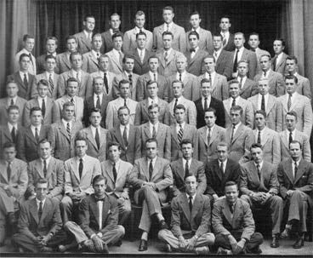
Social Conformity, Unethical Reasoning, and Academic Dishonesty
Vanessa Flores
Notes:
INTRODUCE YOSELF, Today I will be speaking about the relationship between the three variables of social conformity, unethical reasoning, and academic dishonesty.
Schools nationally tend to very heavily push for students to continue onto higher education because that would most likely ensure a stable career and successful life, college was seen as a must. Some jobs requiring college education to even be considered. With these being the mentality of the up in coming generation college acceptance have become increasingly rare so when a student gets accepted to a prestigious college they are often seen as the idealistic student and tend to get praised by their family, friends, peers, and school for their hard work. This personally lead me to wonder when students cheat to get into a high ranked college, is the motivation in hopes of eventually getting a successful career OR for the recognition of their achievement.
Schools push students to go to college, and why?
Some jobs require college education

Slide 2
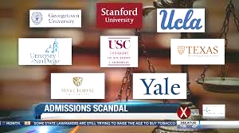

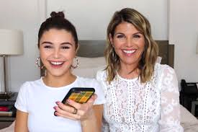
COLLEGE CHEATING SCANDAL

Slide 3
Research Question
Does social desirability have an impact on academic dishonesty and unethical reasoning in adolescents?
Notes:
State research question

Slide 4

FOUNDATIONAL SOURCE
PUBLICATION:
“The Impact of Unethical Reasoning on Academic Dishonesty: Exploring the Moderating Effect of Social Desirability”
Rajesh Iyer
St. Illinois University at Carbondale

Slide 5
FOUNDATIONAL SOURCE
POPULATION: College Students
DATA COLLECTION: Convenience Sampling
SAMPLE: 301 undergraduate students
INSTRUMENTS: Paper survey
Rajesh Iyer
St. Illinois University at Carbondale

Slide 6
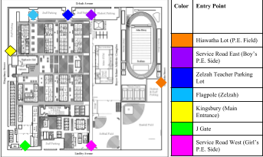
ALIGNED RESEARCH
POPULATION: High school students
DATA COLLECTION: Random stratified sampling
SAMPLE: 103 GHCHS students
INSTRUMENTS: Chromebooks, Rajesh Iyer’s survey

Slide 7
THREE VARIABLES OF FOCUS
SOCIAL DESIRABILITY
UNETHICAL REASONING
ACADEMIC
DISHONESTY
Iyer, Rajesh, and Jacqueline K. Eastman. “The Impact of Unethical Reasoning on Academic Dishonesty: Exploring the Moderating Effect of Social Desirability.” Marketing Education Review, vol. 18, no. 2, Summer 2008, pp. 21–33
Notes:
How social desirability impacts that relationship between unethical reasoning and academic dishonesty and whether is makes it stronger or weaker.

Slide 8
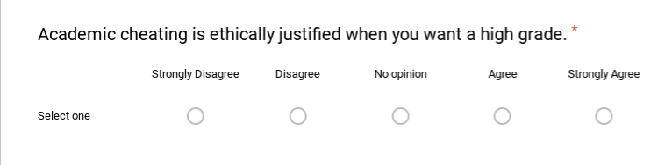
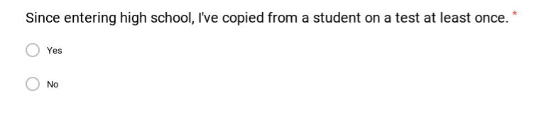
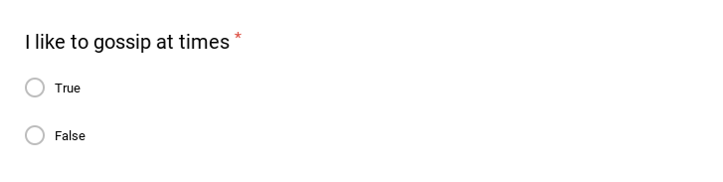
Survey Structure
UNETHICAL REASONING
LIKERT SCALE
ACADEMIC DISHONESTY
YES OR NO
SOCIAL DESIRABILITY
TRUE OR FALSE

Slide 9
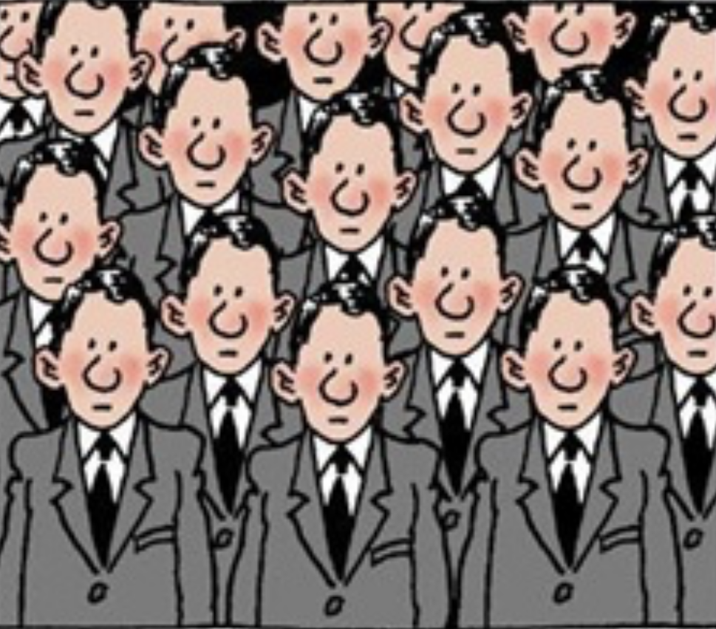

SUB POPULATIONS
NON CONFORMIST
CONFORMIST
VS

Slide 10
What makes one socially desirable?
I LIKE TO GOSSIP
FALSE
TRUE
LOW SOCIAL DESIRABILITY PERCEPTION
HIGH SOCIAL DESIRABILITY PERCEPTION

Slide 11
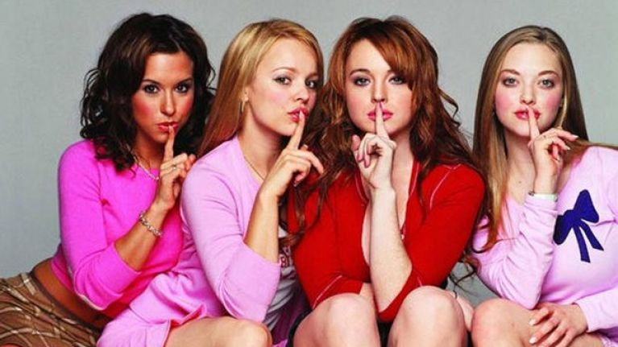
Measures of Social Desirability
CONFORMITY GROUP
5-10 TRUES
27% of sample are conformist
NON CONFORMITY GROUP
0-4 TRUES
73% of sample are non- conformist

Slide 12
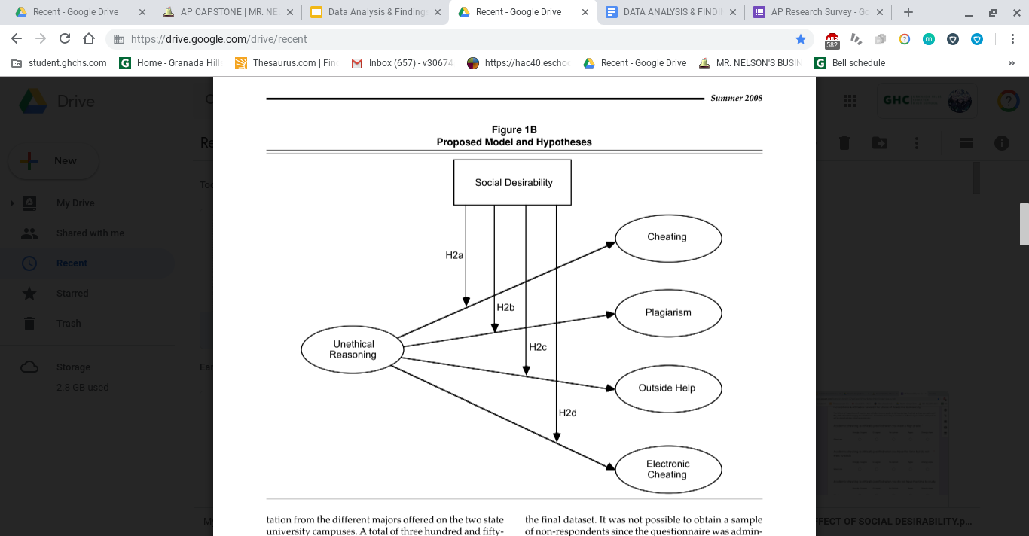
BREAKDOWN

Slide 13
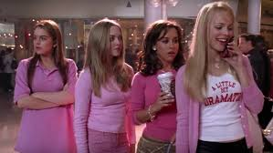
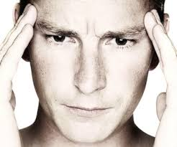
Relationship
SOCIAL DESIRABILITY
UNETHICAL REASONING

Slide 14
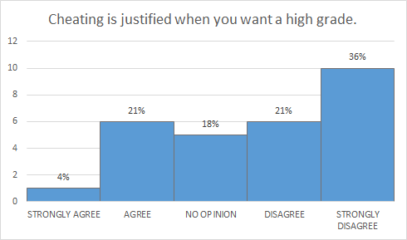
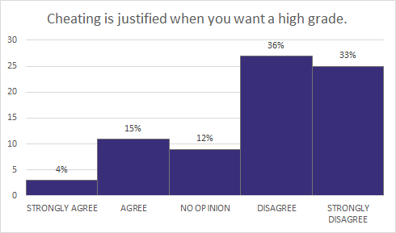
Unethical Reasoning - Self image
CONFORMIST
AGREE : 25%
DISAGREE: 57%
NON CONFORMIST
AGREE: 19%
DISAGREE: 69%

Slide 15
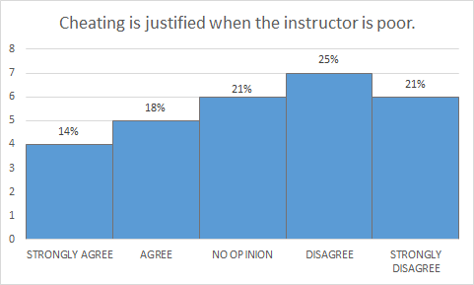
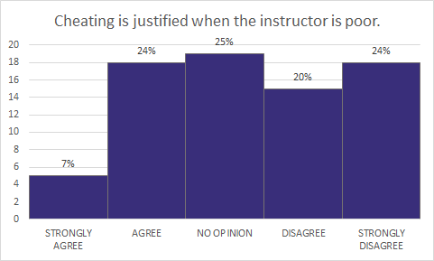
Unethical Reasoning - Environmental
CONFORMIST
AGREE : 32%
DISAGREE: 46%
NON CONFORMIST
AGREE: 31%
DISAGREE: 44%

Slide 16
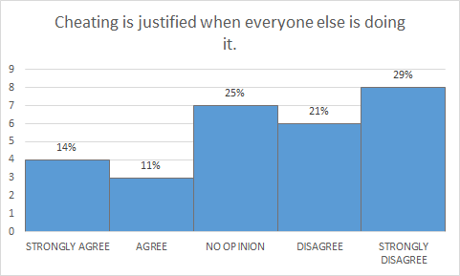
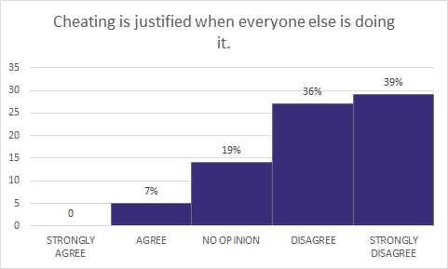
Unethical Reasoning - Social
CONFORMIST
AGREE : 25%
DISAGREE: 50%
NON CONFORMIST
AGREE: 7%
DISAGREE: 75%

Slide 17
Hypothesis - Ha
SOCIAL DESIRABILITY
UNETHICAL REASONING
CHEATING
HA: Students with low social desirability perception will have a stronger relationship between unethical reasoning and cheating behaviors.

Slide 18
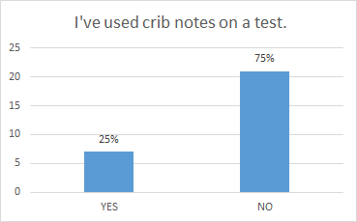
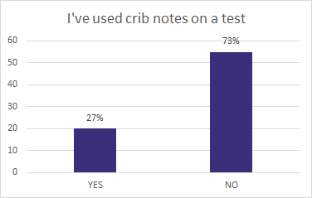
Cheating
CONFORMIST
YES : 25%
NO: 75%
NON CONFORMIST
YES: 27%
NO: 73%

Slide 19
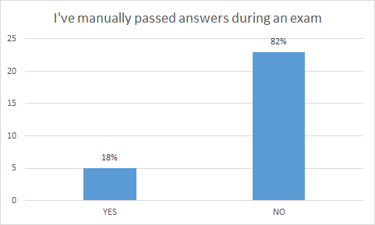
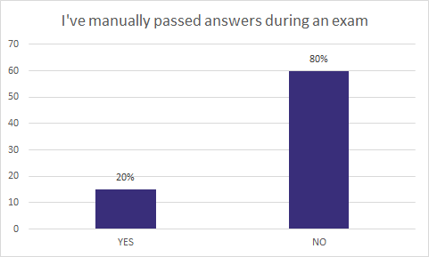
Cheating
CONFORMIST
YES : 18%
NO: 82%
NON CONFORMIST
YES: 20%
NO: 80%

Slide 20
Hypothesis Hb
SOCIAL DESIRABILITY
UNETHICAL REASONING
PLAGIARISM
HB: Students with low social desirability perception will have a stronger relationship between unethical reasoning and plagiarism.

Slide 21

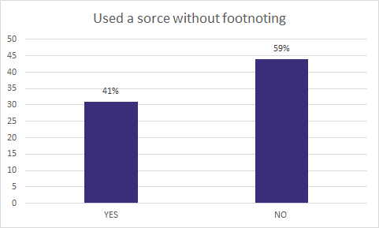
Plagiarism
CONFORMIST
YES : 18%
NO: 82%
NON CONFORMIST
YES: 41%
NO: 59%

Slide 22
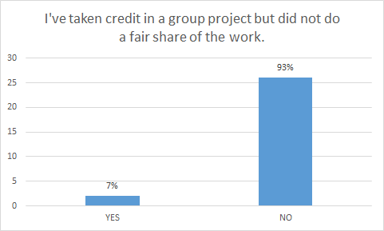
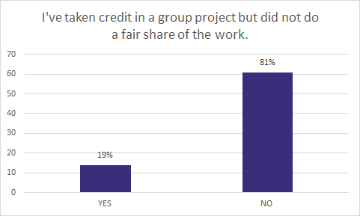
Plagiarism
CONFORMIST
YES : 7%
NO: 93%
NON CONFORMIST
YES: 19%
NO: 81%

Slide 23
Hypothesis Hc
SOCIAL DESIRABILITY
UNETHICAL REASONING
OUTSIDE HELP
HC: Students with low social desirability perception will have a stronger relationship between unethical reasoning and outside help .

Slide 24
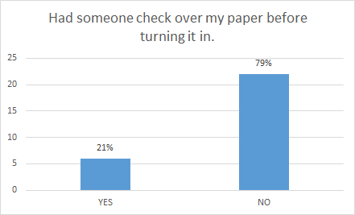
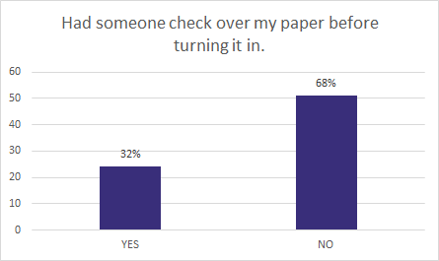
Outside Help
CONFORMIST
YES : 21%
NO: 79%
NON CONFORMIST
YES: 32%
NO: 68%
Notes:
21% of group 1 admitted to cheating
32% of group 2 admitted to cheating

Slide 25
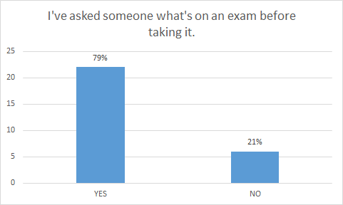
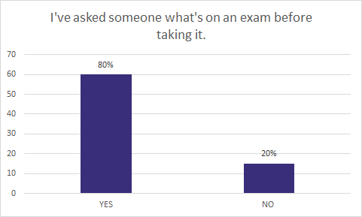
Outside Help
CONFORMIST
YES : 79%
NO: 21%
NON CONFORMIST
YES: 80%
NO: 20%
Notes:
Statistically insignificant
1% difference

Slide 26
Hypothesis Hd
SOCIAL DESIRABILITY
UNETHICAL REASONING
ELECTRONIC CHEATING
HD: Students with low social desirability perception will have a stronger relationship between unethical reasoning and electronic cheating .

Slide 27
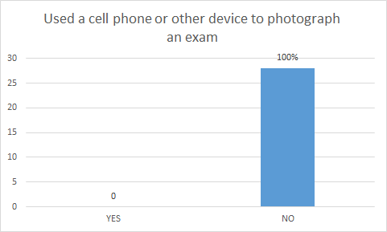
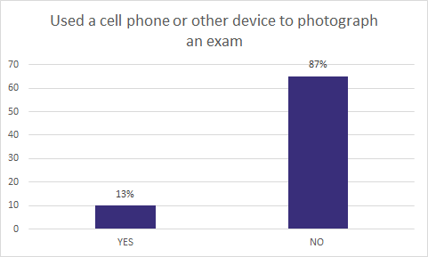
Electronic Cheating
CONFORMIST
YES : 0%
NO: 100%
NON CONFORMIST
YES: 13%
NO: 87%
Notes:
Staying consistent with the trend of the other hypotheses
Non conformist continue to have a larger percentages of yes’s vs. non conformist

Slide 28
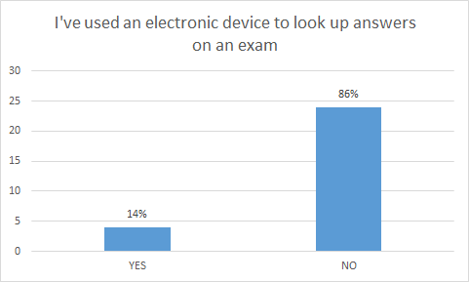

Electronic Cheating
CONFORMIST
YES : 14%
NO: 80%
NON CONFORMIST
YES: 19%
NO: 81%

Slide 29


Foundational vs. Aligned Findings
FOUNDATIONAL
ALIGNED
HYPOTHESIS A
CHEATING

Slide 30
Foundational vs. Aligned Findings
FOUNDATIONAL
ALIGNED
HYPOTHESIS A
CHEATING
HYPOTHESIS B
PLAGIARISM

Slide 31
Foundational vs. Aligned Findings
FOUNDATIONAL
ALIGNED
HYPOTHESIS A
CHEATING
HYPOTHESIS B
PLAGIARISM
HYPOTHESIS C
OUTSIDE HELP

Slide 32
Foundational vs. Aligned Findings
FOUNDATIONAL
ALIGNED
HYPOTHESIS A
CHEATING
HYPOTHESIS B
PLAGIARISM
HYPOTHESIS C
OUTSIDE HELP
HYPOTHESIS D
ELECTRONIC

Slide 33
REFLECTION OF FINDINGS

Slide 34
IMPLICATIONS
WHY DID THE ALIGNED RESULTS DIFFER?
Conformity traits ultimately influenced the results
WHAT CAN BE SEEN AS THE LARGER PICTURE?
Unethical reasoning responses can help instructors see the faults in the current education system

Slide 35
LIMITATION
WHAT LIMITATIONS COULD HAVE ALTERED MY CONCLUSIONS?
Sampling method may have impacted the total amount of respondents from each subpopulation.
Bias in foundational source’s results and conclusions

