Slide 1

AP® Research Student Workbook Activity Slides 2015

Slide 2
Big Idea 4: Synthesize Ideas — Moving from a Literature Review to My Own Research

Slide 3
Persuasive Essay vs. Informative Essay vs. Research Paper
Components | Persuasive Essay | Informative Essay | English Class Research Report
Introduction | Identify problem (proposition/assertion) | Introduction of topic | Define the topic
Body | Take a stance (pro/con) and generate claims with appropriate evidence to support your stance using a variety of appeals (logos, pathos) Address anticipated challenges to argument | Summarize and organize major findings based on pertinent information Contains facts and information, not personal opinion based on fact with the goal of educating audience. | Identify the information you need to understand the topic Select the best sources Extract relevant data Organize, synthesize, and present information from multiple sources
Conclusion | Present final conclusion with the goal of “winning” by persuading your audience to accept your position. | Make conclusion flow from the facts and synthesis presented in body of paper | Make conclusion (including significance) flow from the facts and synthesis presented in body of paper
Notes:
Thoughts – generally “persuasive” writing is differentiated from “argument” in the English classroom through a few nuances that include: persuasion often assumes that the author/speaker has the goal of “winning” by successfully persuading their intended audience. There is also often the assumed element of the use of emotional reasoning with a Persuasive Essay. (appeals to Pathos, don’t you know!) Whereas, “Argumentation” assumes logical reasoning (as opposed to emotional appeals) to convince the audience. Most courses (college and high school) now use the umbrella of argument to include a number of subcategories, and persuasion would fall under this umbrella.

Slide 4
Components of the AP Research Academic Paper
Required Element | Description
Introduction | Provides background and contextualizes the research question/project goal and initial student assumptions and/or hypotheses. Introduces and reviews previous work in the field, synthesizing information and a range of perspectives related to the research question/project goal. Identifies the gap in the current field of knowledge to be addressed.
Method, Process, or Approach | Explains and proves justifications for the chosen method, process, or approach.
Results, Product, or Findings | Presents the findings, evidence, results, or product.
Discussion, Analysis, and/or Evaluation | Interprets the significance of the results, product, or findings; explores connections to the original research question/project goal. Discusses the implications and limitations of the research or creative work.
Conclusions and Future Directions | Reflects on the process and how this project could impact the field. Discusses possible next steps.
Bibliography | Provides a complete list of sources cited and consulted in the appropriate disciplinary style.

Slide 5
AP Research vs. AP Seminar-Differences in Processes and Product
Identifying the gap in the current field of knowledge to be addressed
Asking a question (that has yet to be answered)
Addressing personal assumptions, hypotheses, and/or definitions
Situating that question into the larger body of work on that topic
Explaining and providing justification for the chosen method, process, or approach for data/information collection and analyses.
Coding, categorizing, analyzing, and evaluating that data for its merit in supporting your assumptions and hypotheses pertaining to one’s question.
Notes:
Connecting research question to the knowledge of the field
Introducing and reviews previous work in the field, synthesizing information and a range of perspectives related to the research question/project goal.

Slide 6
AP Research vs. AP Seminar-Differences in Processes and Product
Making a conclusion, claim, or new understanding that is a new piece of information or piece of the puzzle, and then finding how it connects to the larger body of knowledge.
Discussing limitations, significance, implications of research
Reflecting on possible next steps or secondary study
This process ensures that one who engages in scholarly research is part of the academic conversation (even starting an academic conversation) and not just repeating the parts of the conversation.
Notes:
For this slide, an important distinction to make is that this is an evidence-based piece, the primary purpose of which is to present evidence to answer a research question. …as opposed to the other varieties (above) which are either ONLY to present information, or PRIMARILY to persuade the audience of the author’s point by (by appeals to emotion at times), rather than to explore the various associated/appropriate perspectives related to the area of investigation. (and of course, the others do not touch on methodology, credibility or reliability of evidence, etc)

Slide 7
Identifying the Gap
Students do not have to read thousands of scholarly, peer-reviewed articles and foundational texts to make sure that their research question has never been asked before.
However, students’ research questions should be narrow enough in scope, focus, population, genre, etc. the student can reasonably rationalize that their particular question/study has not been performed before.
It should be obvious from 1-3 foundational texts and 15-20 scholarly, peer-reviewed sources/articles that the student’s inquiry will add to the body of the knowledge of the field and not simply report back what is already known.

Slide 8
Activity 1: Bridging AP Seminar to AP Research and Beyond

Slide 9
Create Your Bridge
Compare the AP Seminar individual paper rubric to the AP Research academic paper rubric (See Appendices 30 and 32).
Identify the similarities and differences of the required components and demonstration of skills for both papers.
Use the bridge below to label what skills and essential knowledge (at a very high level) are needed to cross over from the end of the AP Seminar course to the end of the AP Research course.
Be prepared to show your bridge and report what you think the content and skills are that bridge AP Seminar to AP Research.

Slide 10
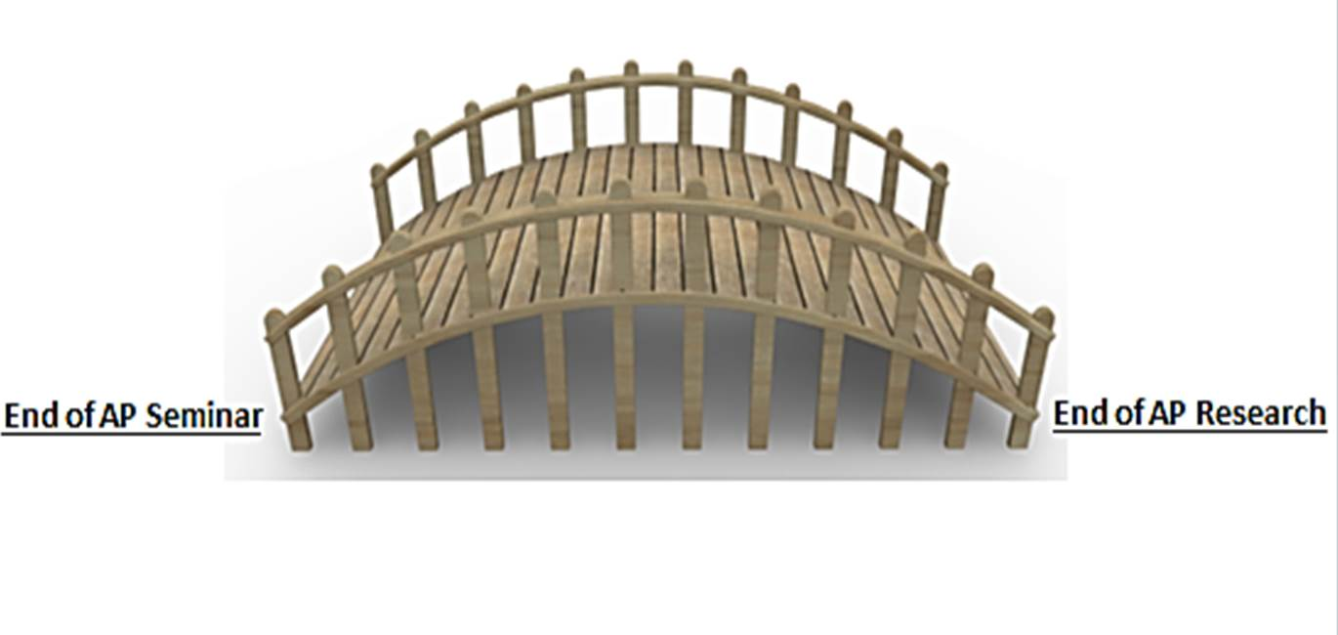
Synthesize new knowledge
Choose aligned method
Develop effective RQ
Identifying a gap
Example Bridge

Slide 11

The Body of Knowledge (what is known)
The Phenomenon
Notes:
Point out that engaging in research is different from debating, or making an argument, or taking a stance. It’s about asking a question (that has yet to be answered about a phenomenon). The green puzzle pieces linked together represent what is currently known through research about that phenomenon (this is the body of knowledge). Students must find a gap in the understanding of the phenomenon or body of knowledge and situatie that question into the larger body of work on that topic, gathering data/information about that specific topic, coding, categorizing, analyzing, and evaluating that data for its merit in supporting your assumptions and hypotheses pertaining to one’s question. Next one must make a conclusion or claim that is a new piece of information or piece of the puzzle, and then find how it connects to the larger body of knowledge. This process ensures that one who engages in scholarly research is part of the academic conversation and not just repeating the parts of the conversation.

Slide 12




Change in Knowledge of the Field about a Phenomena as Student Engages in Research
Gathering, coding, categorizing, analyzing
synthesizing
Evaluating
Evaluating
reviewing
connecting
und
Larger body of
work
und
situating
und
und
und
Before the student engages in research
Student interacting with knowledge of field
Student adding to the body of knowledge
Notes:
Click the mouse to show how this graphic was made. This graphic pertains to collection of Primary Source Data-synthesis of unknown information-usually in sciences (social, natural, physical, hard)

Slide 13
Change in Knowledge of the Field about a Phenomena as Student Engages in Research
synthesizing
Evaluating
Evaluating
reviewing
connecting
Gathering, coding, categorizing, analyzing
und
Larger body of
work
und
situating
und
und
und
Before the student engages in research
Student interacting with knowledge of field
Student adding to the body of knowledge
Notes:
Click the mouse to show how this graphic was made. This graphic pertains to Secondary Source Data collection for a meta study and re-interpretation of what is already known into a new perspective or new understanding-usually in humanities, arts, histories

Slide 14
Activity I Continued
After reviewing the Power Point animation about what the body of the knowledge of the field looks like as the student interacts with it and engages in research, how would you (if at all) revise the tasks or skills it would take for a student to cross over from AP Seminar to AP Research?
Share out your revised bridge if called upon.
Develop a series of guiding questions to help you reflect on whether you are engaging only in debate or a review of the literature instead of situating, gathering evidence to their own question, and creating new knowledge.
Share your guiding questions with the rest of the class

Slide 15
Questions for Reflection
1. Look at the Academic Paper rubric (Appendix 32) rows 4-8. What is the difference in achievement with this performance task between a student who successfully completes these rows and those who go beyond?
2. How well will students perform on the academic paper if they engage in a debate on the pros and cons of an issue and form their own stance? Is this enough?
3. How will you demonstrate that the question you are asking and the knowledge or understanding that you are creating through your study is new and not already known?

